Slide 1


Quinton Butterfield | Francisco Hohn | Fernanda Lowe | John Yoo

Slide 2

How can ML help solve ‘Fake News’ problem?
Content
Defining Fake News
Vectors and Visualizations
Problems with chosen ML Model
Redefining Fake News
Talos and Lessons from the Fake News Competition
Conclusion

Slide 3

Defining Fake News
“A made-up story with an intention to deceive” - The New York Times
“Fake news consists of deliberately false stories that appear to come from credible, journalistic sources. They’re designed to be spread around the internet — previously as jokes, but increasingly often, to influence political opinion.” - AP News
“You are fake news” - Donald Trump

Slide 4
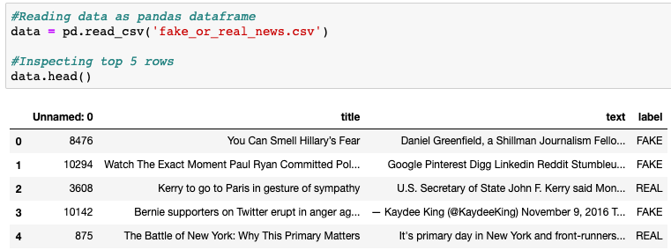
Pandas: Getting to know the data

Slide 5
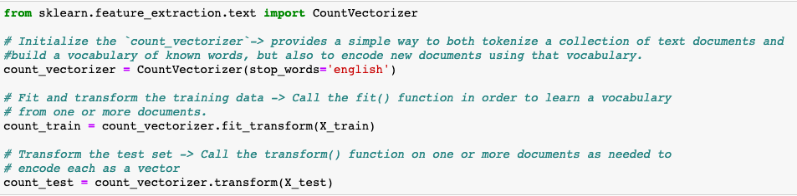
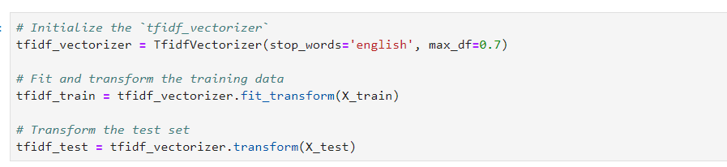
Vectors: a collection/array of numbers - example: [1,3,2] vecor

Slide 6
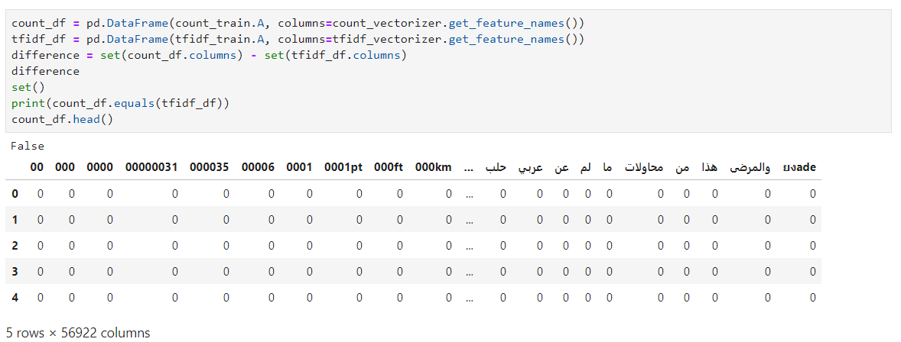
Tokenized Data

Slide 7
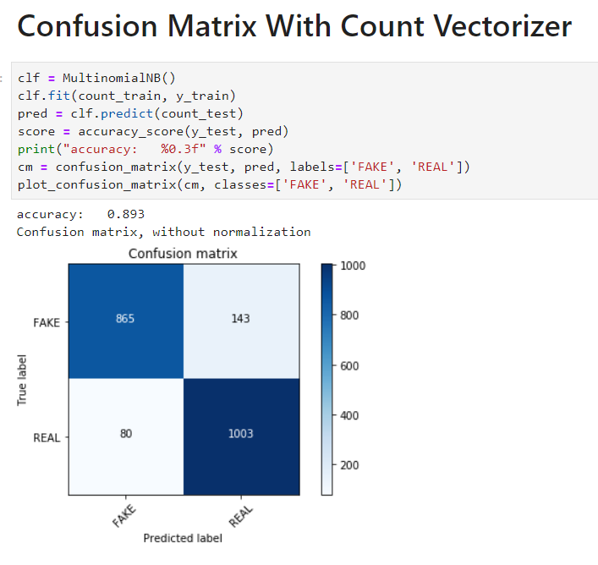
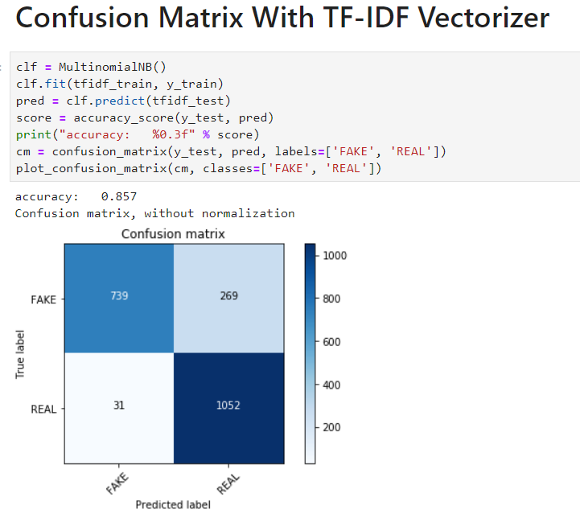
Using MultinomialNB to compare Vectorizers through Matplotlib Confusion Matrix
MultinomialNB is a NLP (Natural Language Processing) Model
MultinomialNB works well for data which can easily be turned into counts, such as word counts in text (works better with the CountVectorizer
We use Matplotlib’s Confusion Matrix for easy visualization
CountVertorizer 89.3%
TF-IDF Vectorizer(Term Frequency - Inverse Document Frequency) - 85.7%

Slide 8
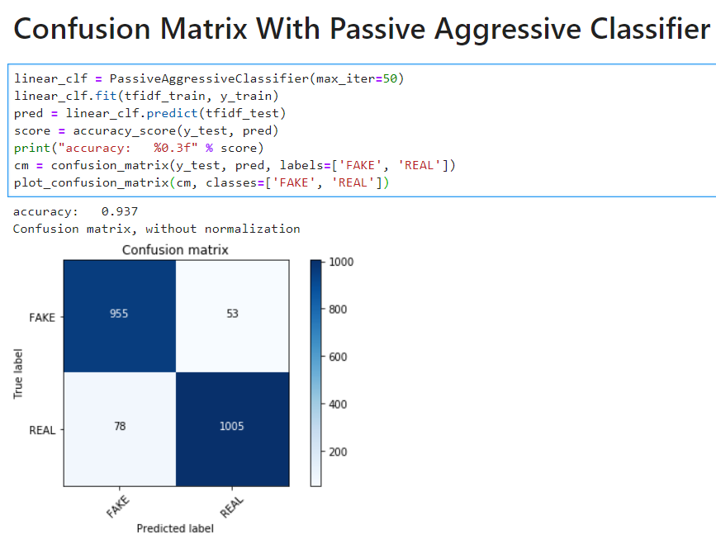
Using the Passive Aggressive Classifier with TF-IDF
Linear models like SVM work better with the TF-IDF vectorizer
The Passive Aggressive Classifier is a type of linear model. It is perfect for classifying massive streams of data. Easy to implement and very fast but does not provide guarantees like SVM.
93.4% accuracy! Wow!
There seems to be several models and vectorizers we can use to increase accuracy but before we get crazy and try all of them...

Slide 9
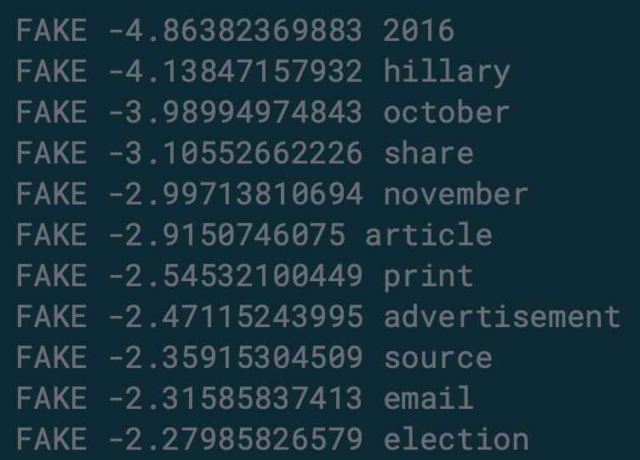
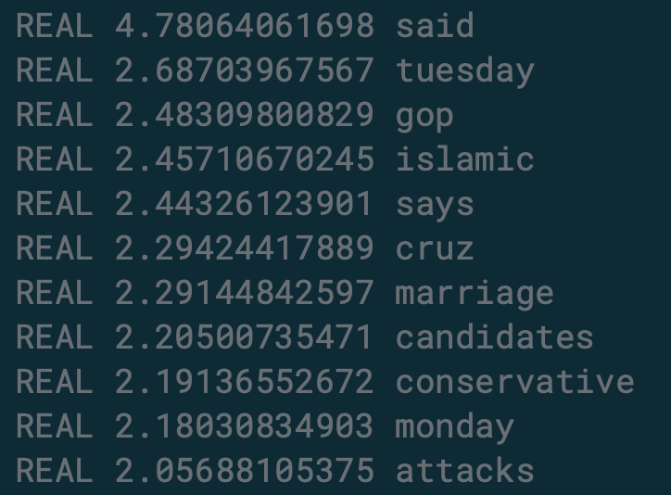
Why this solution doesn’t work
Modeling based on vectoring which did counts of words.
Does not take into account context or word ordering.
Word can be classified as fake or real, but that does not mean that the article that contains those words are guaranteed to be real or fake. Just because a word shows up more often in a fake or real article, does not guarantee that article is fake or real.
Another flaw is the data is subjective and prone to bias, based on who created the dataset.
We need something more robust to determine fake news as the definition of fake news is very broad.
Notes:
Lets talk about why our method is not the best way to solve this ongoing problem with identifying fake news.
We used words like vectorizing and tokenizing, but All we are doing is counting up words and associating these with real or fake based on how the training data was tagged by a human. For example, in a lot of the stories that are tagged in the data as fake news stories we may find words like Hillary, October, 2016. And in the ones tagged as real we have Islamic, conservative, attacks.
But just because these words show up in our training data in real or fake articles at certain frequencies doesn't mean they can be used to determine fake news. This approach doesn't take into account the context or word order.
Another flaw is that there is bias since someone tagged news articles as real and fake based on their experience of the world.
This is why a more robust approach is necessary and why the term fake news needs a new definition, from the perspective of the data scientist.
So lets redefine fake news:
According to First Draft news there are 7 types of mis ans dis information and these all need to be taken into account by the data scientist, which one can imagine makes this problem very complicated to solve.

Slide 10
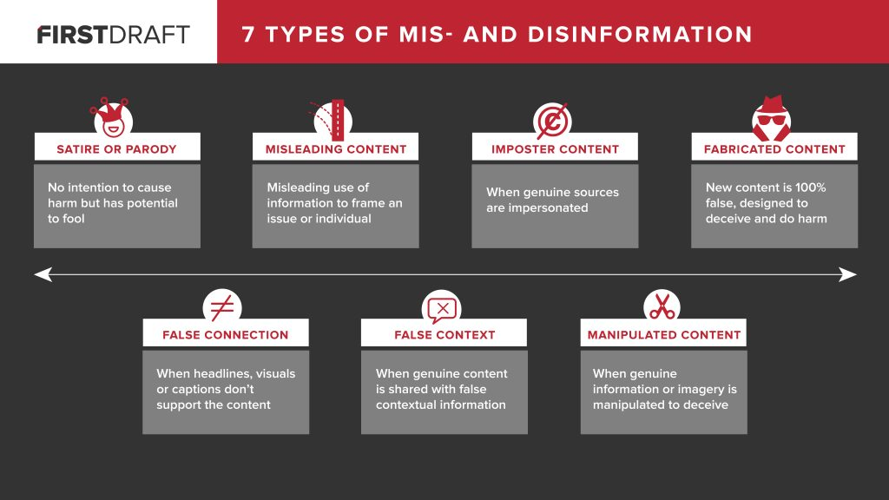
Redefining Fake News
First Draft News, an organisation dedicated to improving standards for information shared online, proposes these 7 types of fake content.

Slide 11
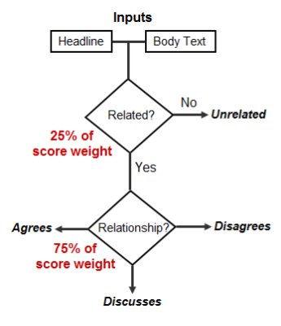
Talos and The Fake News Challenge
Rules :
Use only the data supplied by FNC
Winning teams must open source their solutions
Have Fun!
From December of 2016 to June 2017, over 80 teams from around the globe, including the Cisco owned security intelligence and research group Talos, took on the first stage of a competition offered by Fake News Challenge (FNC), a grassroots effort of volunteers to address the problem of fake news through competition.
Goal : Determine if the headline and the body of an article were in agreement with each other, totally divorced from each other, or degrees in between.
Stance Detection
solves for
False Connection
When headlines, visuals, or captions don’t support the content

Slide 12
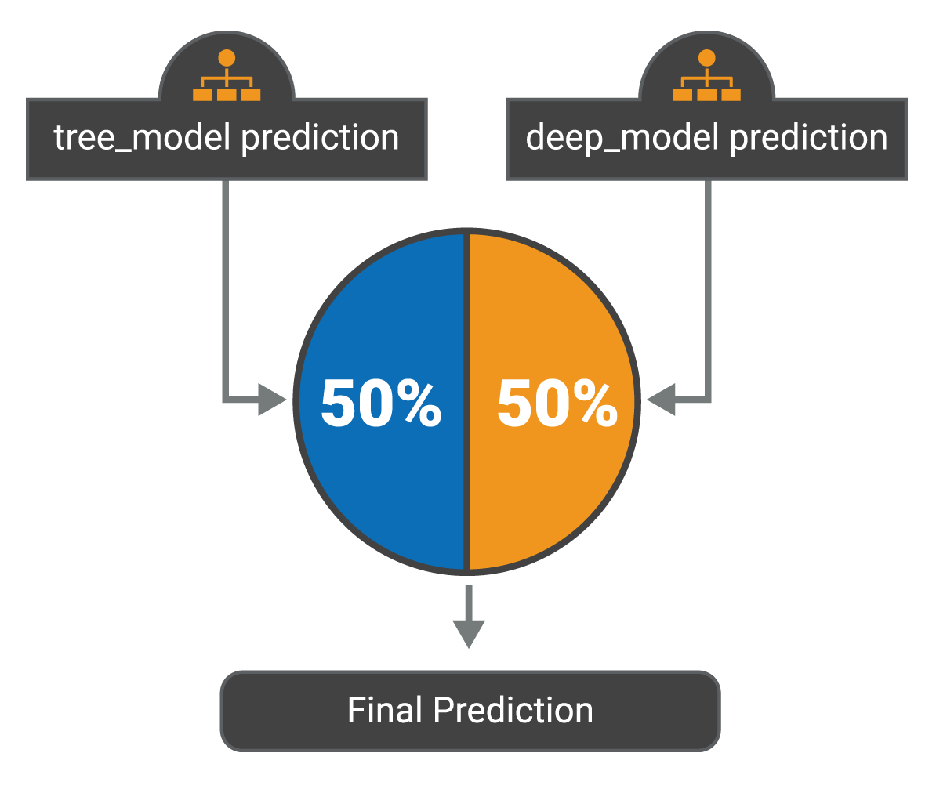
Talos and The Fake News Challenge : The Solution
GBDT
CNN
The team’s final submission was split 50/50 between utilizing gradient-boosted decision trees (GBDT) and a deep convolutional neural network (CNN).
Gradient boosting - a machine learning technique for regression and classification problems, which produces a prediction model in decision trees.
CNN - a Deep Learning algorithm which can take in an input, assign importance to various aspects in the input and be able to differentiate one from the other.

Slide 13
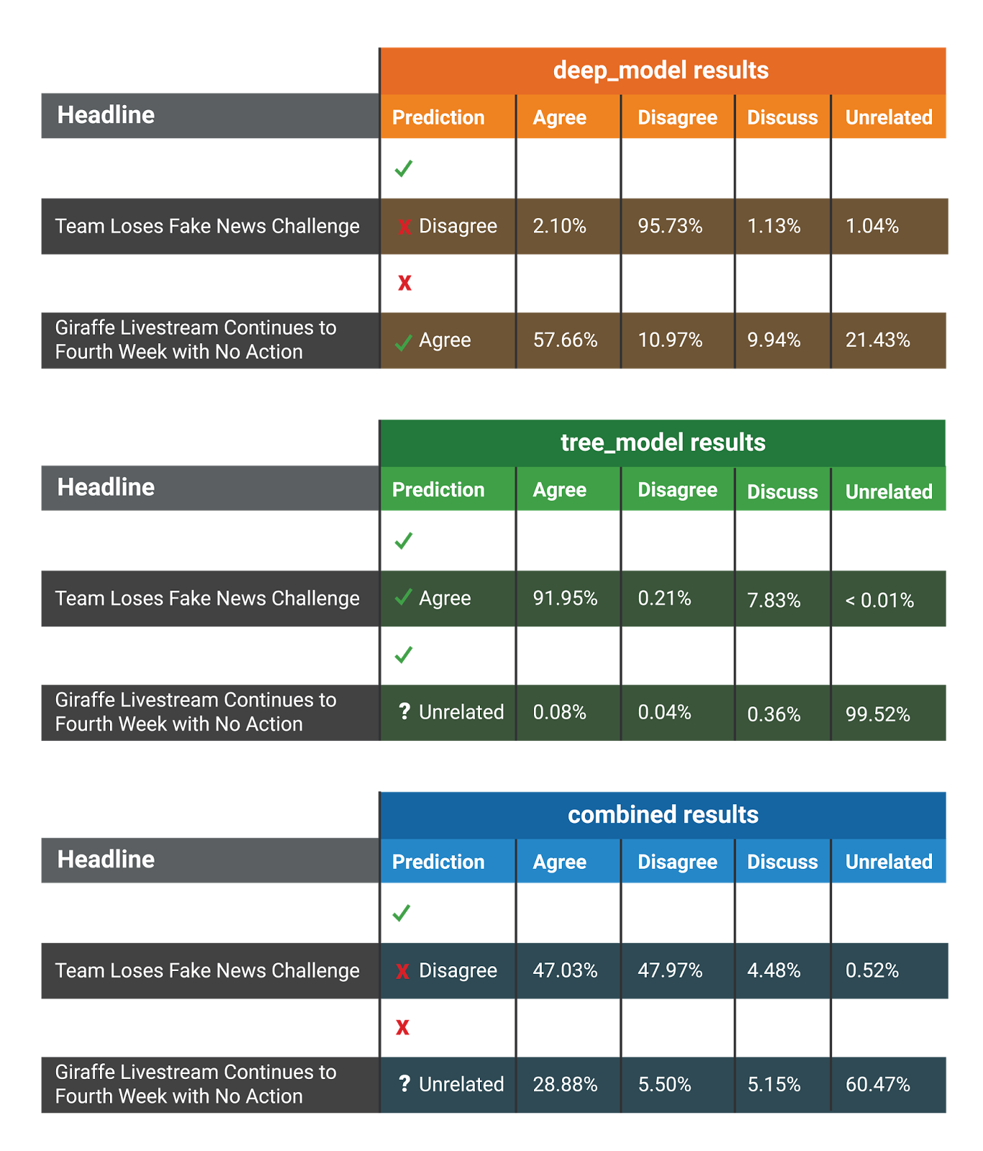
Talos and The Fake News Challenge : The Results
Real Headline
Headlines Disagree
For their efforts, Talos received a grade of 82%, first place in the challenge, and $1,000 cash prize.
All while using ML tools we’ve been exposed to in this boot camp!
Unrelated Headline

Slide 14
1/7
This solution for False Connections is just one part
of solving for the Fake News epidemic.

Slide 15
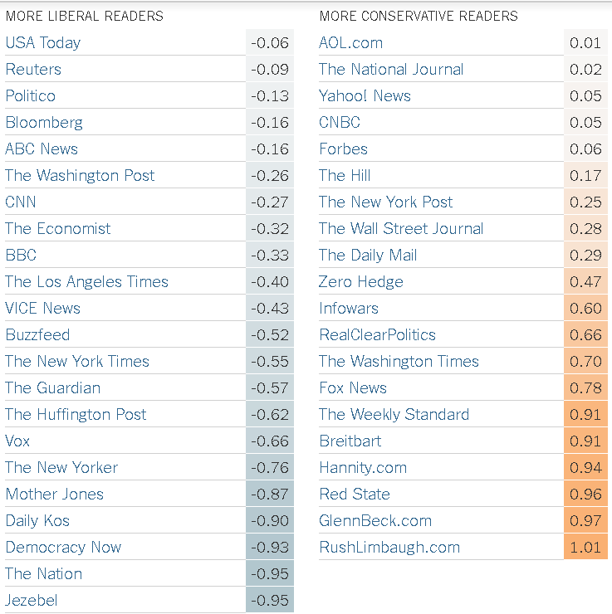
Information Bias
Recent studies suggest that we tend to avoid articles we disagree with.
A -1 indicates a strongly liberal readership, and 1 a strongly conservative readership.

Slide 16
We have the tools to help solve this problem.

Slide 17

THANKS!
And
CONGRATS,
to all of us.
WE DID IT!

Slide 18
Sources
How to Build a “Fake News” Classification Model | https://opendatascience.com/how-to-build-a-fake-news-classification-model/
Detecting Fake News with Scikit-Learn | https://www.datacamp.com/community/tutorials/scikit-learn-fake-news
Text Classification 3: Passive Aggressive Algorithm https://www.youtube.com/watch?v=TJU8NfDdqNQ
Fake News Challenge | http://www.fakenewschallenge.org/
Talos Targets Disinformation with Fake News Challenge Victory | https://blog.talosintelligence.com/2017/06/talos-fake-news-challenge.html
How can Machine Learning and AI help solving the Fake News Problem | https://miguelmalvarez.com/2017/03/23/how-can-machine-learning-and-ai-help-solving-the-fake-news-problem/
A Comprehensive Guide to Convolutional Neural Networks — the ELI5 way |
https://towardsdatascience.com/a-comprehensive-guide-to-convolutional-neural-networks-the-eli5-way-3bd2b1164a53
Gradient Boosting | https://en.wikipedia.org/wiki/Gradient_boosting#Gradient_tree_boosting
We Avoid News We Don't Like. Some Trump-Era Evidence. | https://www.nytimes.com/interactive/2017/02/21/upshot/how-readers-react-to-political-news-they-dont-like-they-ignore-it.html?_r=3

